Slide 1

Mother Earth Has a Fever
Since 1880, due to the dominance of fossil fuels as the primary source of energy, Earth's surface temperature has increased about 1.1 degrees Celsius, or around two percent. Doesn't seem like much until we think about what we feel like when our body temperature reaches 100.5 Fahrenheit.

Slide 2
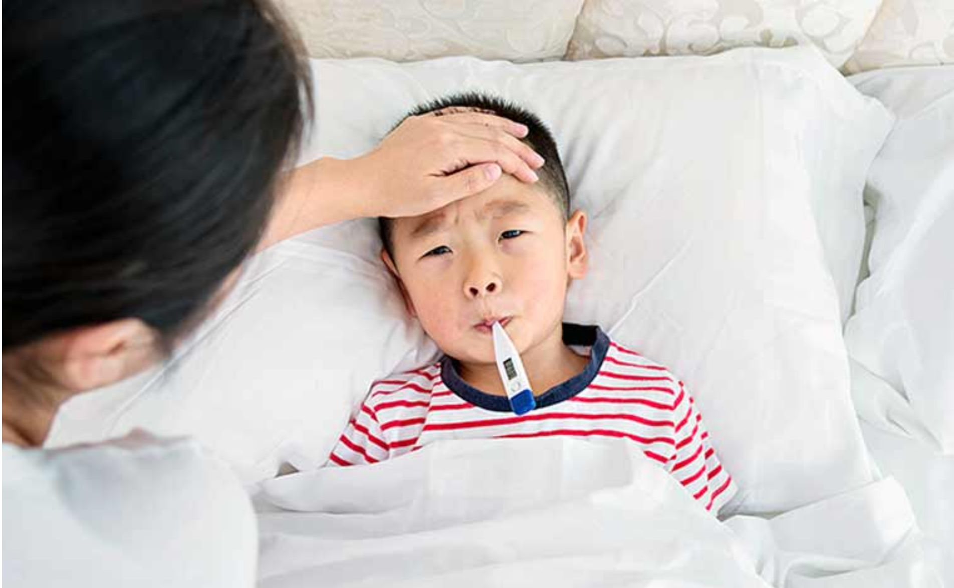
It's Going To Get Worse
Climate science predicts that Mother Earth's fever will rise to the equivalent of a 102.5 Fahrenheit human fever, if we stopped all carbon emissions tomorrow.

Slide 3
(of course, that's not going to happen, by a long shot)

Slide 4


Slide 5
What's Happening Now

Slide 6
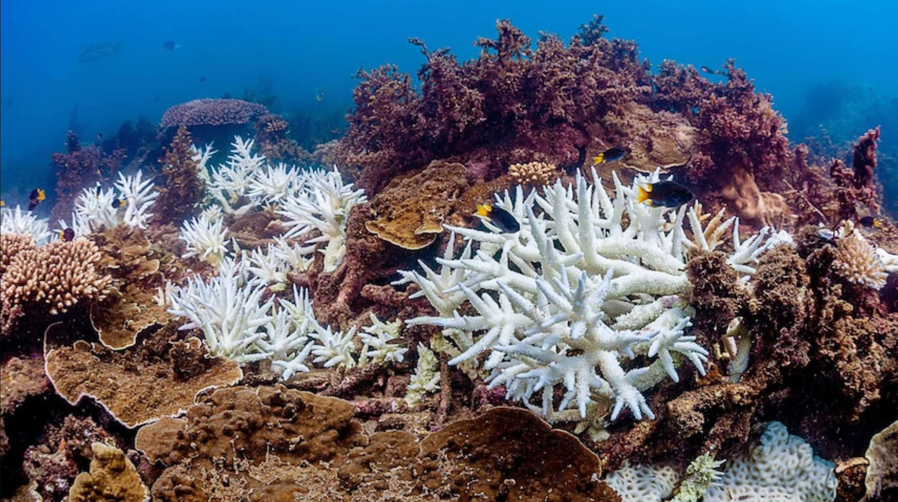
Vast, uncountable number of species extinctions

Slide 7
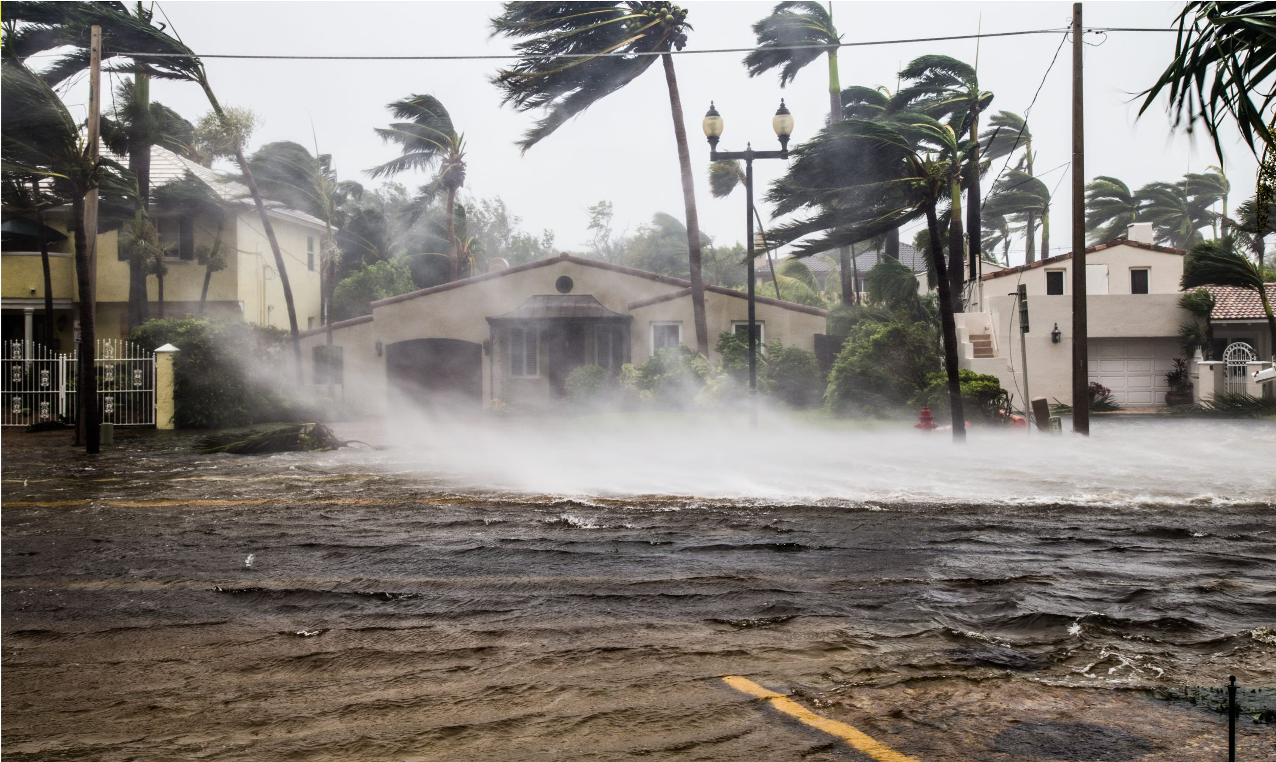
Record number, and severity, of weather-related catastrophes

Slide 8
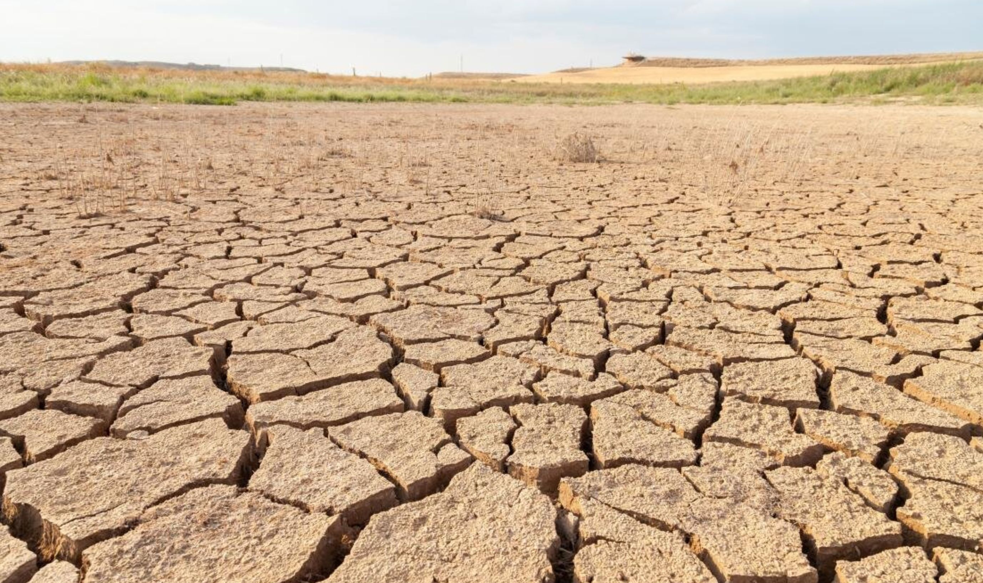
Loss of arable land due to desertification

Slide 9
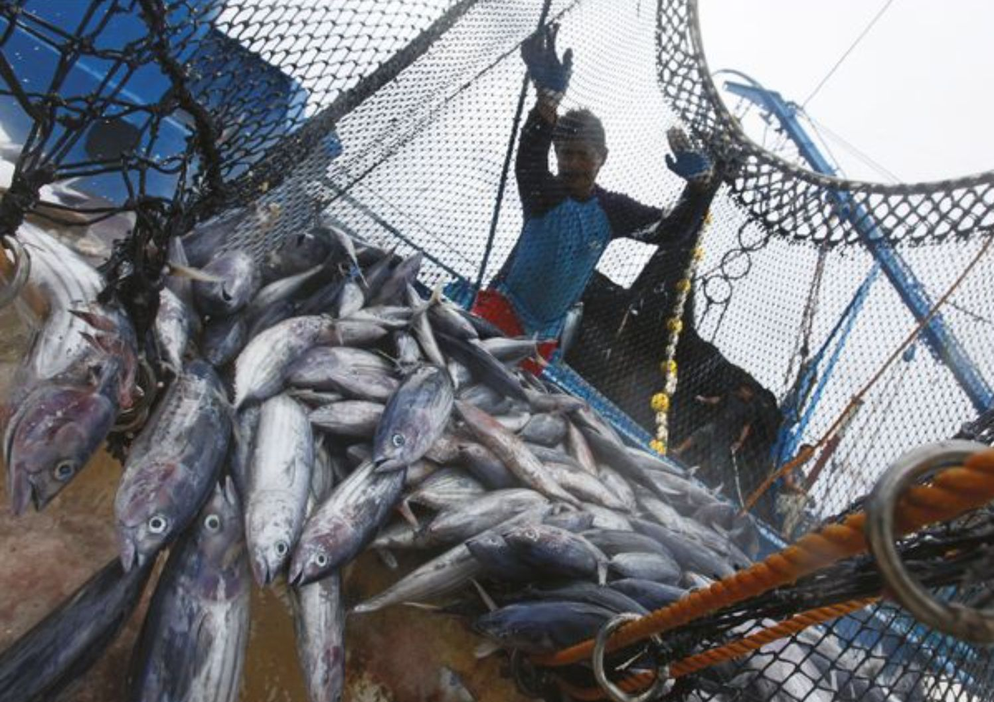
Collapse of fish populations

Slide 10
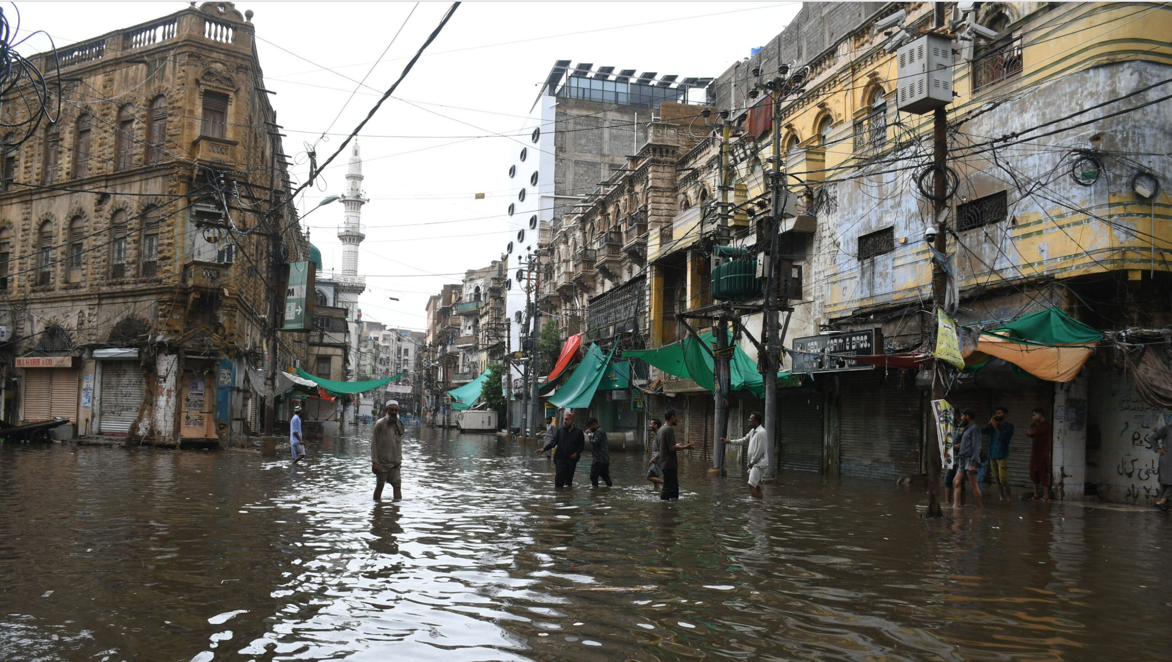
Previously populated areas rendered uninhabitable

Slide 11
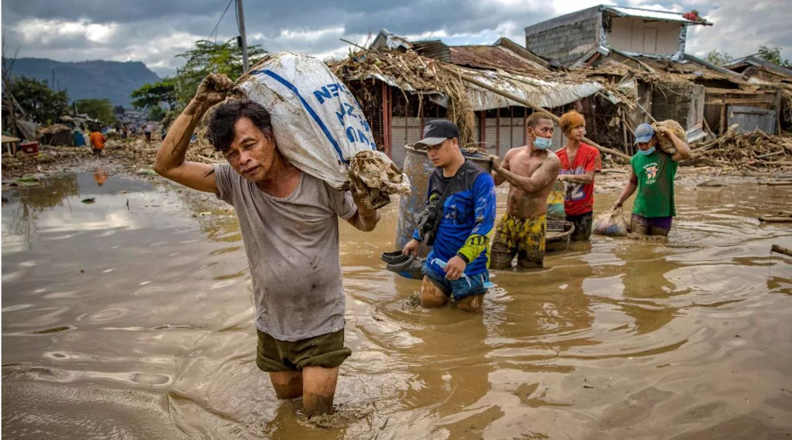
Climate Migration = Climate refugees

Slide 12
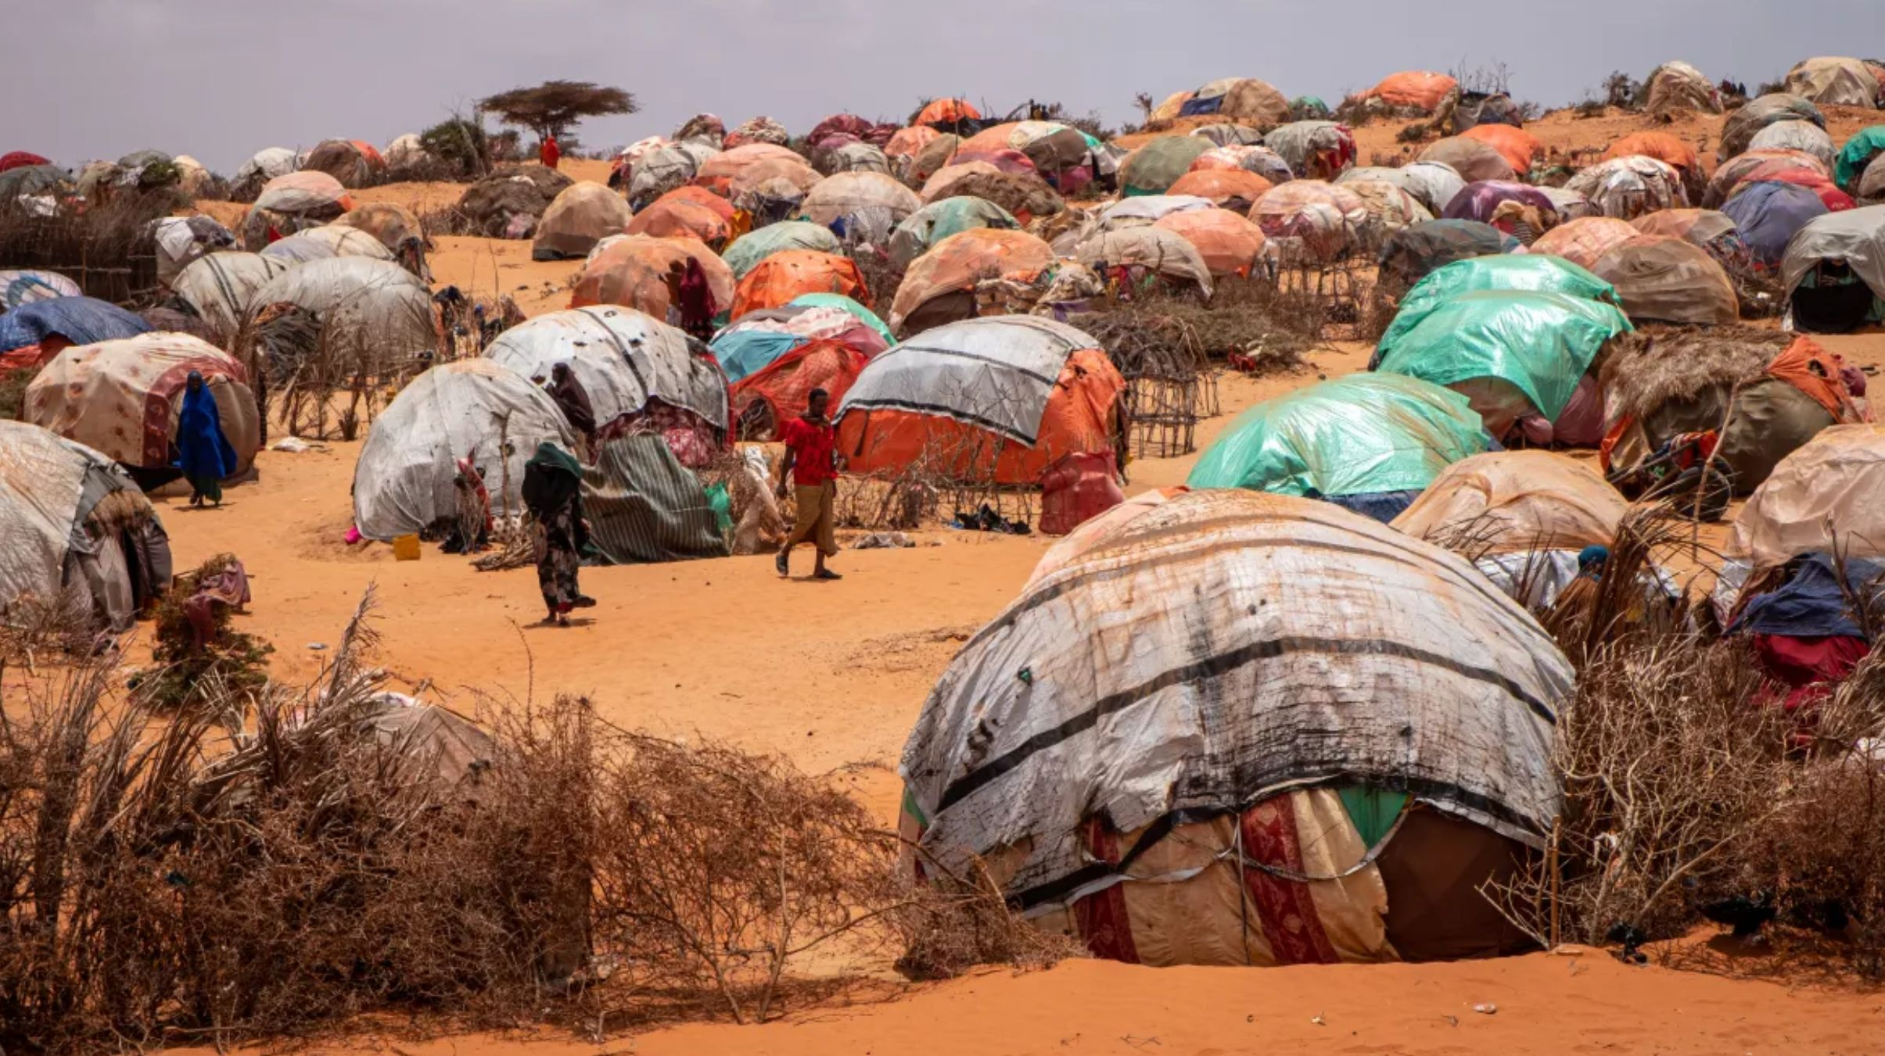
Increasing starvation and food insecurity in the countries that are the very least to blame for the Climate Catastrophe

Slide 13
Queries
What actions have you engaged in or are you currently engaged in that would mitigate the Climate Catastrophe if they were adopted on a massive scale?
What actions have you engaged in or are you currently engaged in that exacerbate the Climate Catastrophe?
How does your spiritual relationship to the planet inform and/or inspire your actions with regard to the Climate Catastrophe?

